Slide 1
The Circuit
Breakers
Team Members-
1. Himanshu Galav (2021EEB1177)
2. Jigyasa Singh (2021EEB1182)
3. Lokesh Jassal (2021EEB1185)
4. Mehul Gupta (2021EEB1188)
5. Pranav Bali (2021EEB1193)
6. Jatin Goyal (2021EEB1180)

Slide 2
Smart wheelchair
( Aid to physically disabled people by incorporating manual operation)
PROBLEM :
Today in India many people are suffering from disability, there are people whose lower half of the body is paralyzed. In India, around 5436604 population is affected from movement disability. The wheelchairs available today are less convenient and manually operated which leads to various issues. Dirtying of hands as a result of pushing one’s own wheelchair forward is one such issue. If sanitary equipment is not at one’s frequent disposable, it may result in serious health disorders as individuals eat or drink with the same dirt intact. Additionally, one must also consider that many individuals – especially those below the poverty line, who are most likely to use manual instead of automated wheelchairs – lack the monetary capacity to fund frequent sanitation against the dirtying of hands. This exacerbates the spread of germs to those they come into contact with. Moreover, using a wheelchair during rain or on uneven surfaces makes it difficult for the user as is takes a lot of physical effort; thus, leaving the user feeling tired. Even some motorized wheelchairs are less convenient because the controller of it is attached on its arm rest, so the user cannot use it remotely and needs others help to sit on it.

Slide 3
Solution
Now a days as most of the people have smartphones; The best solution proposed is – WIRELESSLY CONTROLLED WHEELCHAIR The wheelchair is capable of carrying the load up to 150 kg, and moving in accordance with the command given by the person using the app through the mobile phone. The chair can be controlled by the owner even if he/she isn't sitting on the chair with the help of their mobile phone. User can simulate the wheelchair towards them and then can sit on that wheelchair by themself without the need of another person, with this feature they can feel more independent and self-sufficient. Moreover, having a mobile controlled motorized wheelchair eradicates the problem of using one’s own energy for the movement and the problem of sanitation of their hands.

Slide 4
Principle Bluetooth Wireless Transmission
In communication, the Bluetooth wireless technology has become very popular and it is one of the fastest growing fields in the wireless technology.
The Bluetooth technology manages the communication channel of the wireless part. The Bluetooth modules can transmit and receives the data wirelessly by using two devices. The Bluetooth module can receive and transmits the data from a host system with the help of the host controller interface (HCI).
Here we will be using a mobile phone as the host.

Slide 5
Distance Calculating Waves
Apart from bluetooth technology, we are using ultrasonic waves for calculating the distance between the chair and the obstacle. We know the speed of sound wave in air, i.e. 330m/s. Ultrasonic waves will be transmitted and recieved after strinking the obstacle, the time elapsed will be calculated and hence the distance can be calculated.
Distance = Speed * Time

Slide 6
COMPONENTS AND WORKING

Slide 7
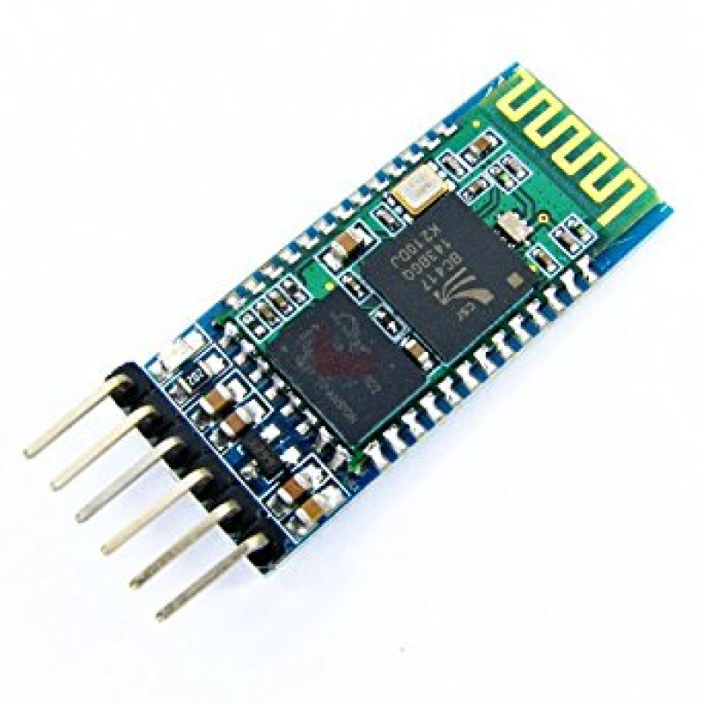
Bluetooth Module HC - 05
A BLUETOOTH MODULE is fitted in the wheel chair receives the radio signals from the smartphone. In this way a wireless transmission of the signals is made.

Slide 8

Arduino
ARDUINO is a type of a microprocessor that controls other components as per the instruction given to it by uploading a code. It consists of some digital, analog, and PMW pins.
The main component of this mmicrocontroller is its ATmega 328p IC.

Slide 9
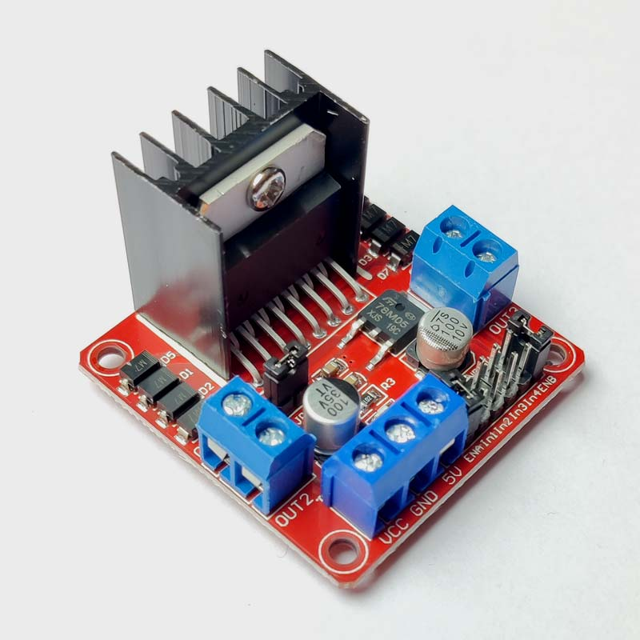
Motor Driver - L298
Motor driver is used to control the direction and speed of the motors connected to it. Also it can power the motors with external batteries of 5 or 12 voltage.

Slide 10
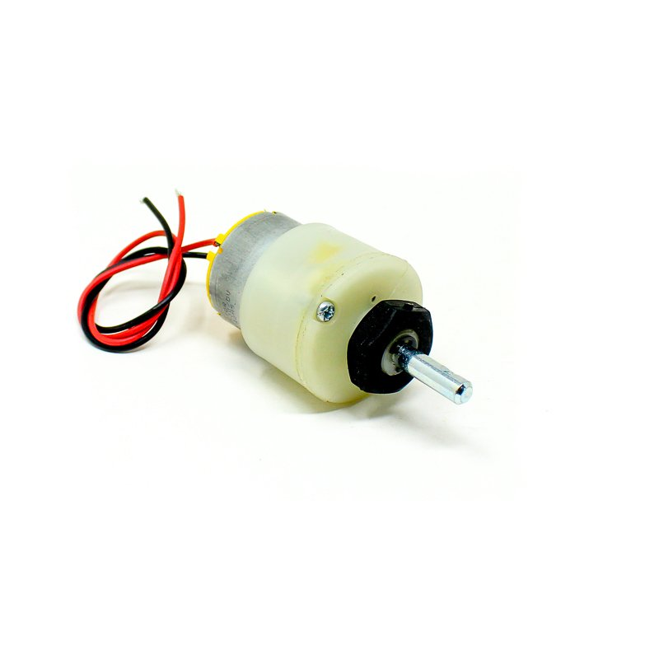
DC Motor
TWO DC MOTORS of high torque are fitted at the back side of the chair which moves the wheelchair left-right, forward-backward and turn around.

Slide 11
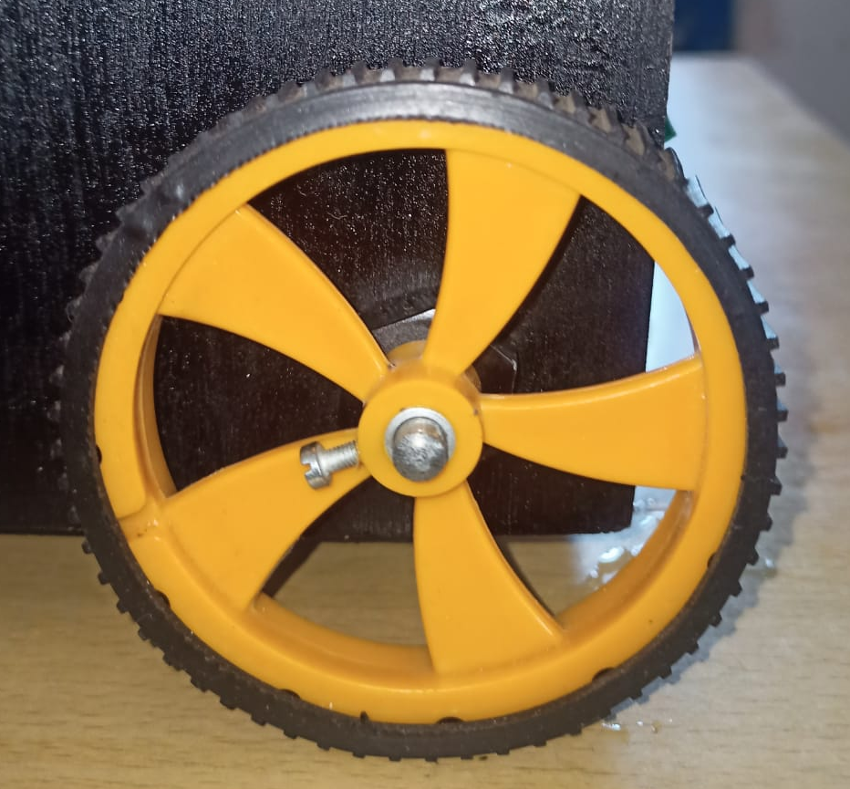
Wheels
TWO WHEELS at the back are connected to the shaft of the motors. One wheel is also connected at the front with a small rod.

Slide 12
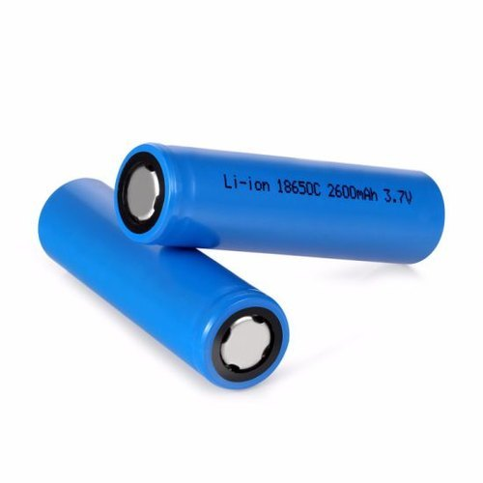
Batteries
The electrical power is supplied by the three rechargeable batteries connected in series. Each battery is of 3.7V which is collectively 11.1V. Near the front wheel, battery charger is fitted which can be used to recharge the batteries.

Slide 13
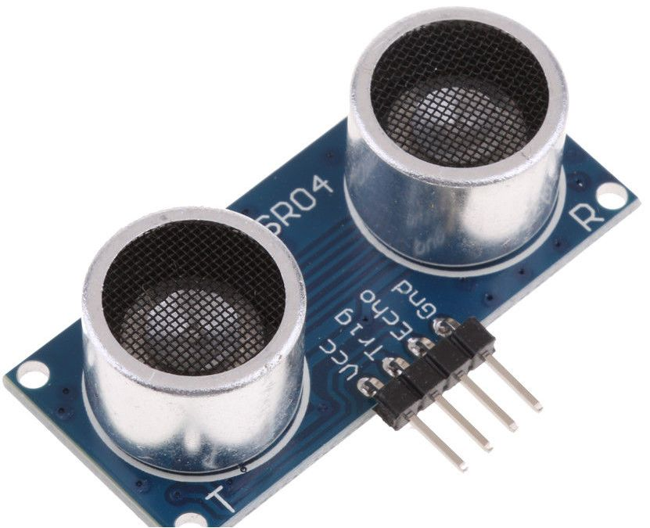
UltraSonic Sensor
Ultrasonic sensor is a type of a senor that is used to measure the distance of a obstacle. It consist of a wave transmitter and a wave reciever. It operates at voltage of 5V.

Slide 14
Arduino Code Explaination

Slide 15
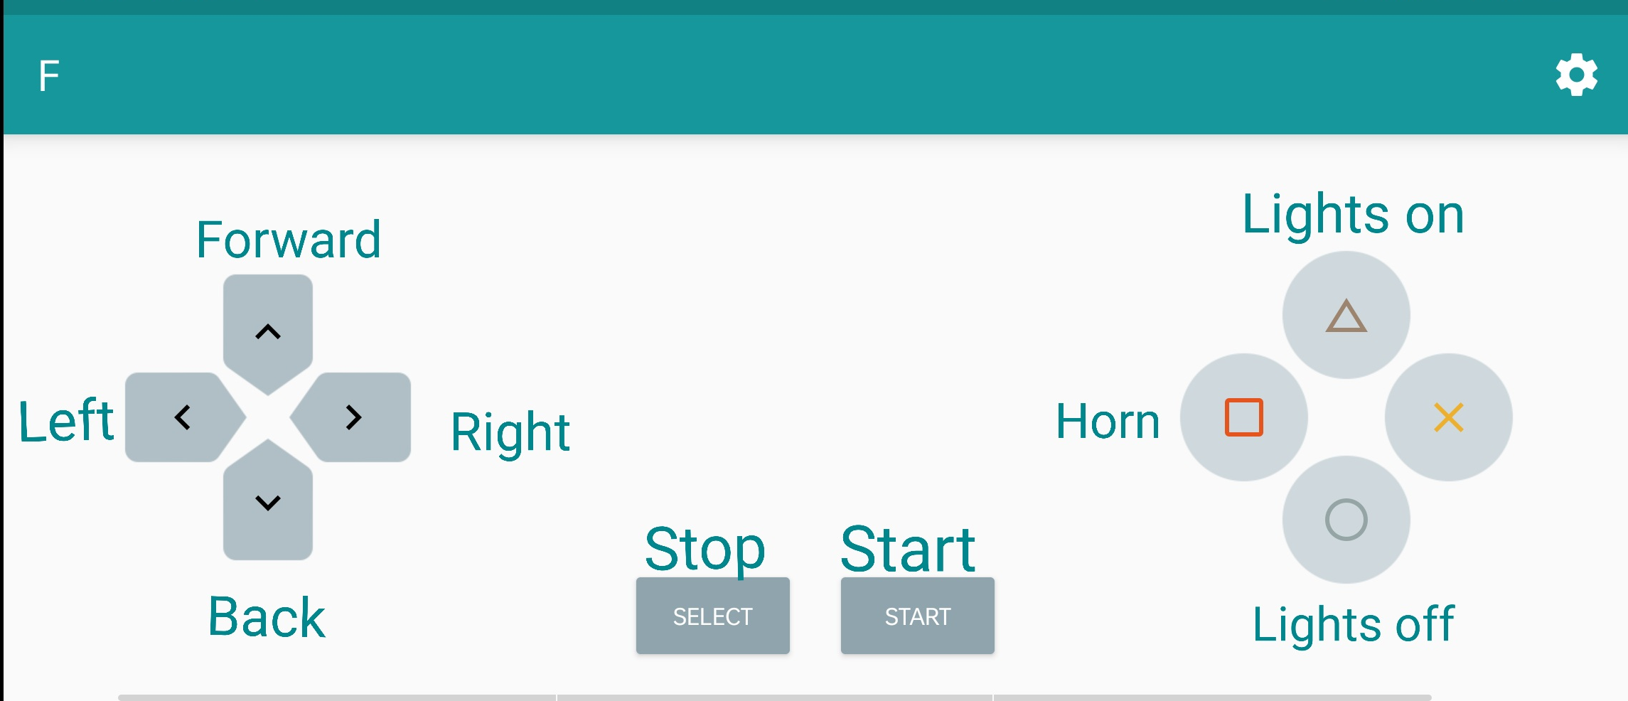
EXECUTION
The wheel chair is controlled by an in the phone.
The app offers a set of commands which are as follows:

Slide 16
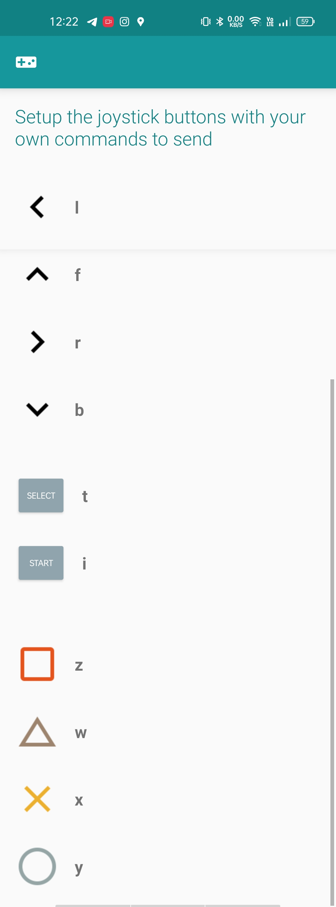
These commands as alphabets are passed to the Arduino by the app which in turn generates a certain movement for the wheel chair.
For ex:
If we press forward tab, the alphabet “f”
is passed to the Arduino which has asset of codes.
It checks the received command in the code and generates the forward movement.
This generated movement is passed onto the motor driver.

Slide 17
FUTURE
In the future a lot of improvisation can be done to our prototype of a wirelessly controlled wheelchair; It can be made much more comfortable by improving the cushioning and high-power motors can be used to increase the load capacity of the chair. Better Bluetooth technology will lead to a better response from the chair and thus increasing the range of the wireless connection. The app used for controlling the wheelchair can also be improved. The cost can be reduced.

Slide 18
THANK YOU

